Slide 1
Sharing common assemblies between processes and domains
Article: https://habrahabr.ru/post/341950/
Source code: https://github.com/sflusov/IISSharingAssemblies

Slide 2
The presentation target
Show the optimization path for your applications
Show a few tools for analyzing optimization paths and their impact on your applications
Tools used in presentation.
Sysinternals Process Explorer v16.21
Sysinternals VMMap v3.21

Slide 3
Agenda
What do you really mean by memory? Memory structure and types.
Sharing assemblies between application domains. Concept domain neutral assembly.
Sharing assemblies between processes. Concept native images.
Real example based on Marketplace development server

Slide 4
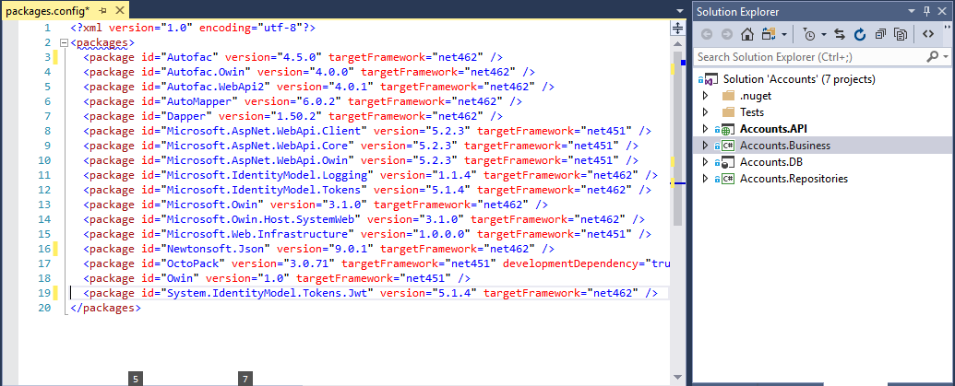
The structure of typical application

Slide 5
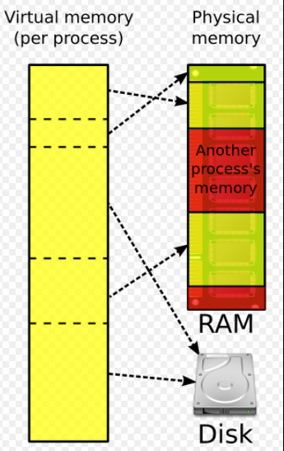
What do you really mean by memory? Virtual and physical memory
Virtual memory:
32-bit - 2GB per process
64-bit – 128TB per process
See also:
http://blogs.microsoft.co.il/sasha/2016/01/05/windows-process-memory-usage-demystified/

Slide 6
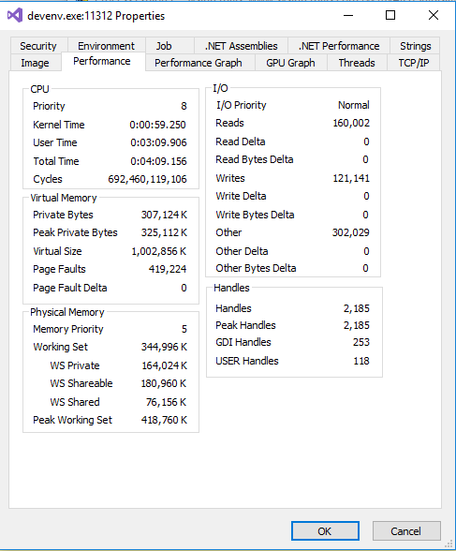
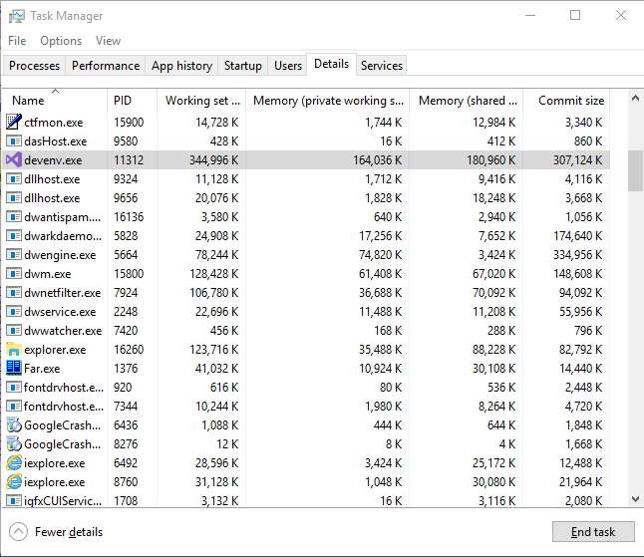
What do you really mean by memory?
Working Set = WS Private + WS Shared
Task manager
Process Explorer

Slide 7
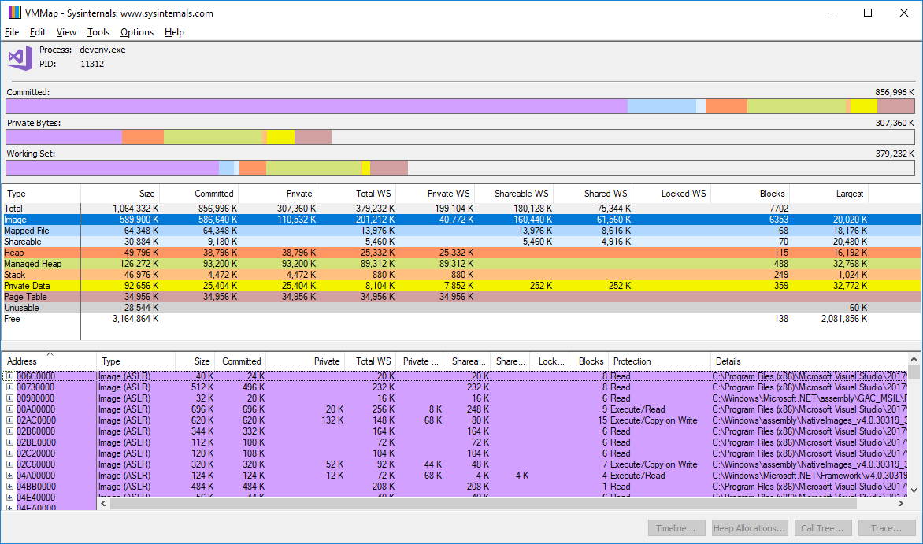
What do you really mean by memory? Welcome to VMMap
See also:
http://blogs.microsoft.co.il/sasha/2016/01/05/windows-process-memory-usage-demystified/
Windows® Sysinternals Administrator’s Reference. Pages 216-218

Slide 8
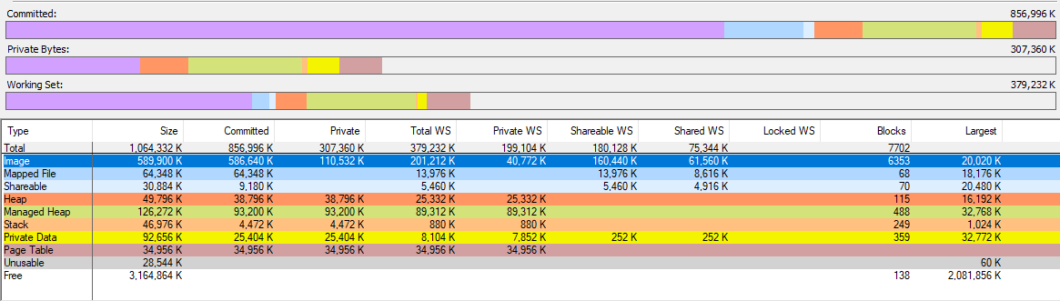
What do you really mean by memory? Memory types
See also:
http://blogs.microsoft.co.il/sasha/2016/01/05/windows-process-memory-usage-demystified/
Windows® Sysinternals Administrator’s Reference. Pages 216-218

Slide 9
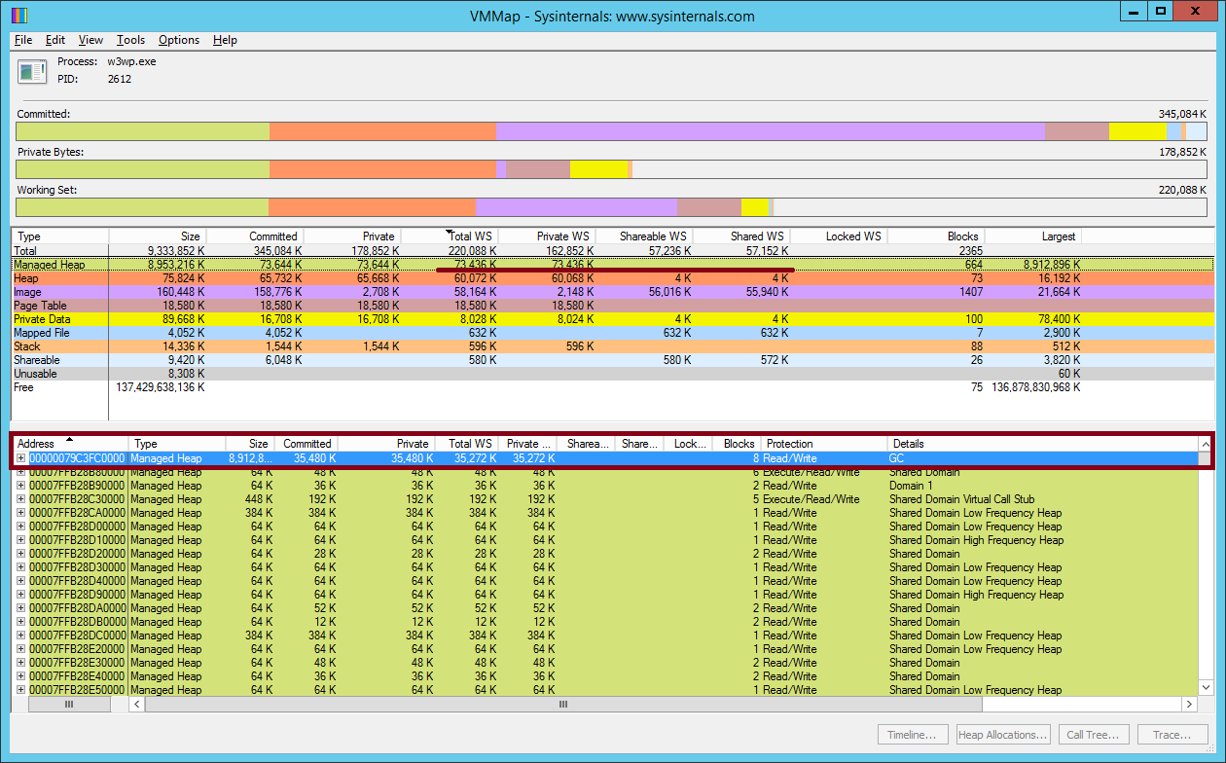
What do you really mean by memory? Memory types
Remarks JIT code included in Managed Heap, you can calculate them size as Managed Heap minus GC

Slide 10
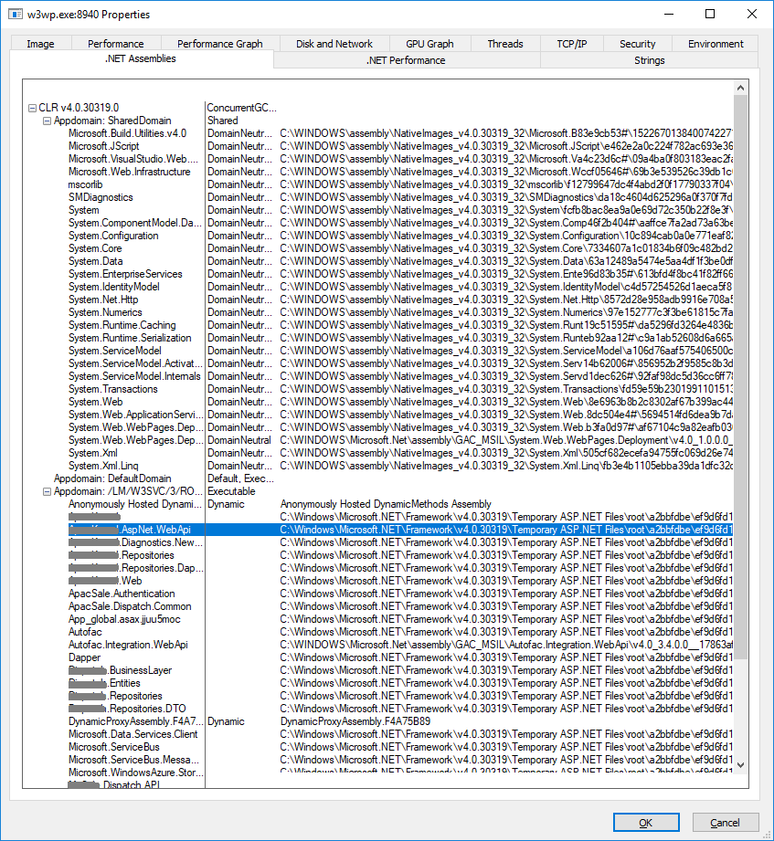
Sharing assemblies between application domains Concept domain neutral assembly
Domain neutral assembly
It lives across multiple appdomains
It will be jitted only once
The jitted code will be shared across appdomains
See also:
https://blogs.msdn.microsoft.com/junfeng/2004/08/05/domain-neutral-assemblies/
Process Explorer
Notes:
Have a look simulation
Have a look real example on MP server

Slide 11
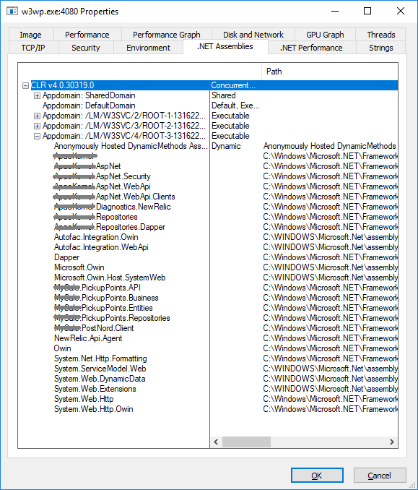
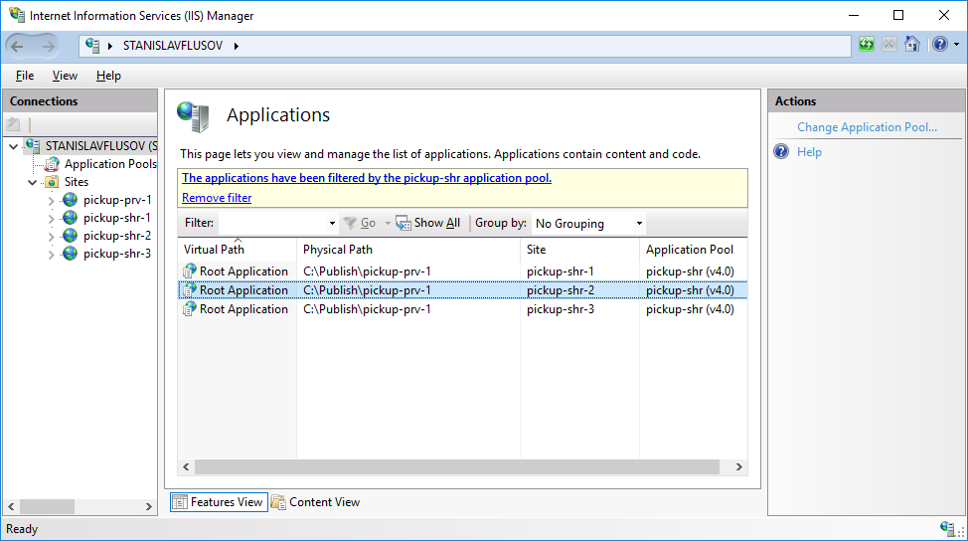
Sharing assemblies between application domains Concept domain neutral assembly
Process Explorer
Notes:
Have a look simulation
Have a look real example on MP server

Slide 12
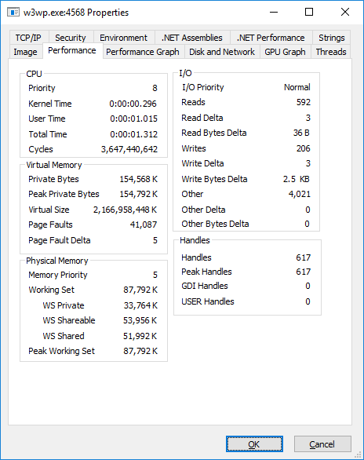

Sharing assemblies between application domains Concept domain neutral assembly
One site in appPool
Three sites in appPool
Notes:
Have a look simulation
Have a look real example on MP server

Slide 13
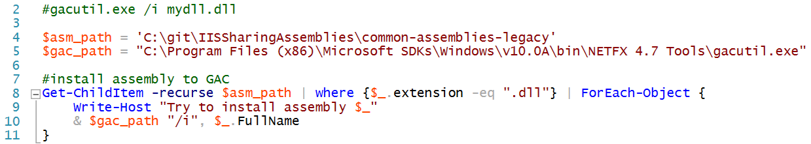
Sharing assemblies between application domains Installing assemblies to Native Images Cache

Slide 14
Sharing assemblies between processes Concept native images. NGEN
Summary of usage
Enable code sharing between processes
Require a smaller initial working set
Load faster than MSIL
See also:
https://docs.microsoft.com/en-us/dotnet/framework/tools/ngen-exe-native-image-generator

Slide 15
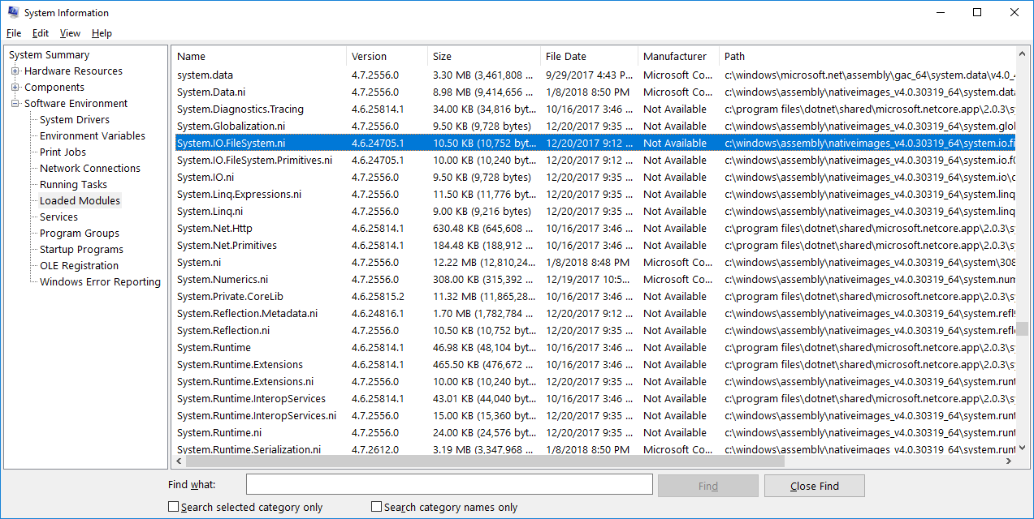
Sharing assemblies between processes Concept native images

Slide 16
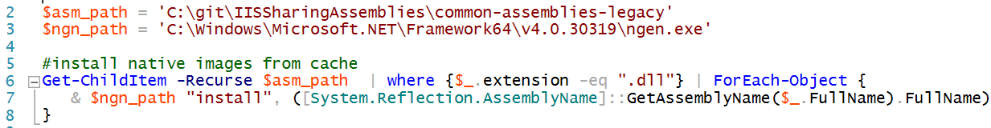
Sharing assemblies between processes Concept native images

Slide 17
Summary
Step | Warming time | Total memory usage | Average memory usage per service
Initial conditions ** | 6 min 43 sec | 8 GB | 7 GB / 47 = 152 Mb
1. App pools combining 2. load lib to GAC ** | 2 min 33 sec | 4.1 GB | 3.1 GB / 47 = 67 Mb
1. App pools combining 2. load lib to GAC 3. make native images | 2 min 12 sec | 2.2 GB | 1.2 GB / 47 = 26 Mb
Remarks:
* There are some deviations in values, because screenshot was made at different time
** NewRelic agent installed

Slide 18
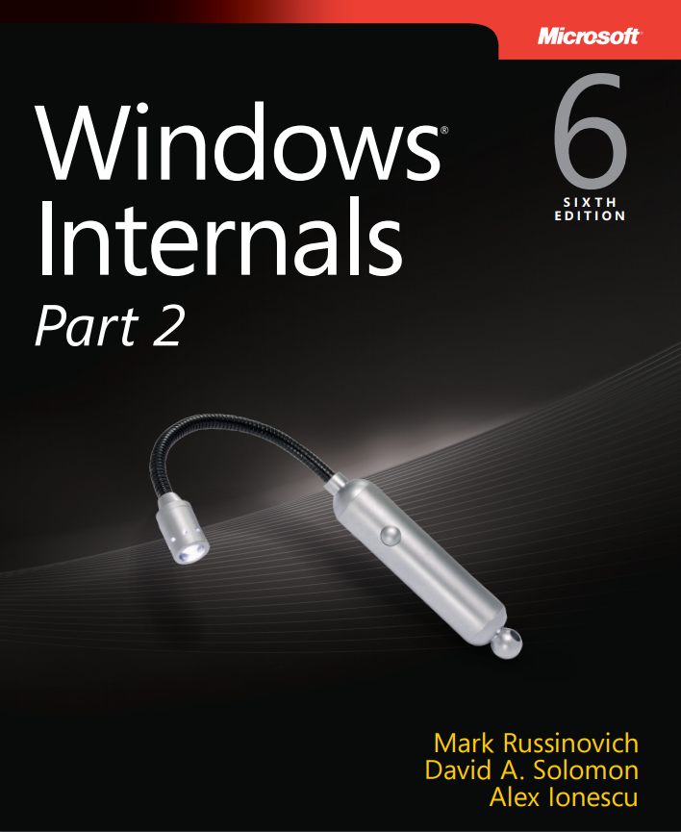
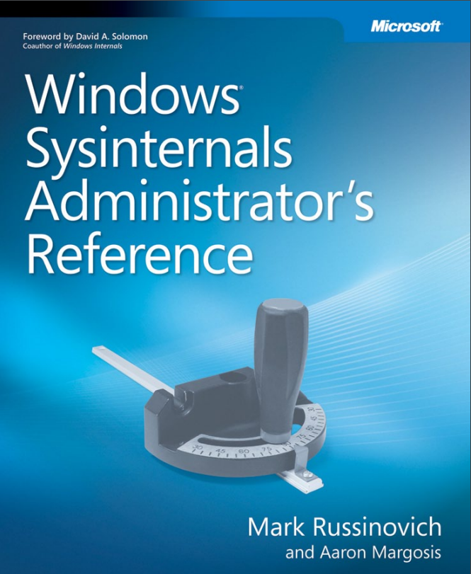
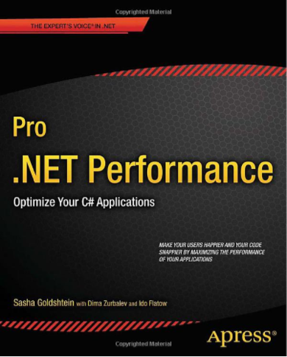
Books recommended for reading
References
https://www.microsoftpressstore.com/store/windows-internals-part-1-9780735648739
https://www.microsoftpressstore.com/store/windows-sysinternals-administrators-reference-9780735656727
http://www.apress.com/us/book/9781430244585

Slide 19
Thank you
Article: https://habrahabr.ru/post/341950/
Source code: https://github.com/sflusov/IISSharingAssemblies

